Slide 1
Quadratic Formula

Slide 2
Factoring
When an equation is in the form:
$ax^{2}+bx+c=0$, you can factor it.
When factored, you can find the zeros of the graph.

Slide 3
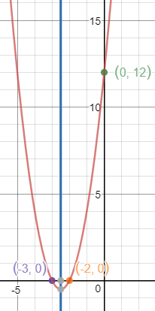
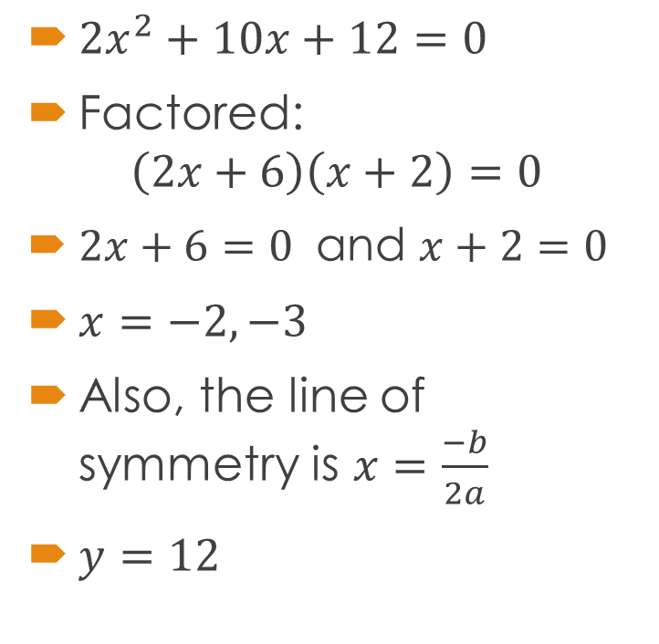
Example
${2x}^{2}+10x+12=0$
Factored:
$$\left(2x+6\right)\left(x+2\right)=0$$
$2x+6=0$ and $x+2=0$
$x=−2, −3$
Also, the line of symmetry is $x=\frac{−b}{2a}$
$y=12$

Slide 4
Quadratic Formula
When a quadratic is in the form:
${ax}^{2}+bx+c=0$, you can use the quadratic formula to find the zeros of the functions. (Where x = 0)
$$\frac{−\left(b\right)± \sqrt{{(b)}^{2} −4(a)(c)}}{2(a)}$$

Slide 5

Example
${2x}^{2}+10x+12=0$
$a=2, b=10, c=12$
$\frac{−\left(b\right)± \sqrt{{(b)}^{2} −4(a)(c)}}{2(a)}$
$\frac{−\left(10\right)± \sqrt{{(10)}^{2} −4(2)(12)}}{2(2)}$
$\frac{−\left(10\right)± \sqrt{4}}{4}$
$\frac{−10+2}{4}=−2$
$\frac{−10 −2}{4}=−3$

Slide 6
The Discriminant
The discriminant is the part under the square root: $\frac{−\left(b\right)± \sqrt{{(b)}^{2} −4(a)(c)}}{2(a)}$
A positive discriminant means there are 2 real roots.
A zero discriminant means there is a double root.
A negative discriminant means there are 2 complex roots.

